Slide 1


Cab Investment firm Go-to-Market strategy
Internship Case Study by
RAGHAVI GURURAJAN

Slide 2
Process in this Data Analysis
Defined the business task
Collected the data from the data source
Cleaned the data thoroughly and created Master data
Analyzed the Data
Interpret the results and gave the final insight

Slide 3
Client Background
XYZ is a private firm in the US. Due to remarkable growth in the Cab Industry in last few years and multiple key players in the market, it is planning for an investment in Cab industry.
As per their Go-to-Market(G2M) strategy they want to understand the market before taking final decision.
Objective: To provide insights and recommendations to help them identify the right company to make their investment.

Slide 4

Data Exploration
Used the below mentioned datasets:
Cab_Data.csv – this file includes details of transaction for 2 cab companies
Customer_ID.csv – this is a mapping table that contains a unique identifier which links the customer’s demographic details
Transaction_ID.csv – this is a mapping table that contains transaction to customer mapping and payment mode
City.csv – this file contains list of US cities, their population and number of cab users
The chosen dataset ranges between 31/01/2016 to 31/12/2018.
Total data points:581715
Assumed that Users can be for both the companies
Calculated the profit using the cost_of_the_trip and Price_charged
Removed the null and Blank values

Slide 5
The no. of users were increasing in Yellow Cabs in 2016

Slide 7
The sum of Profit is evidently higher in Yellow Cab Company

Slide 8
The age group of 18-40 had more users in Yellow cab company than in Blue Cab with Gender attribute in consideration

Slide 9
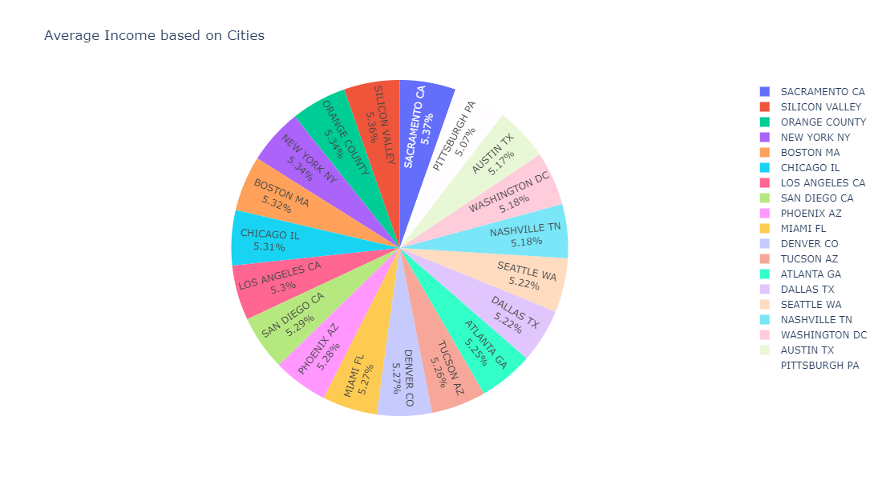

Slide 10
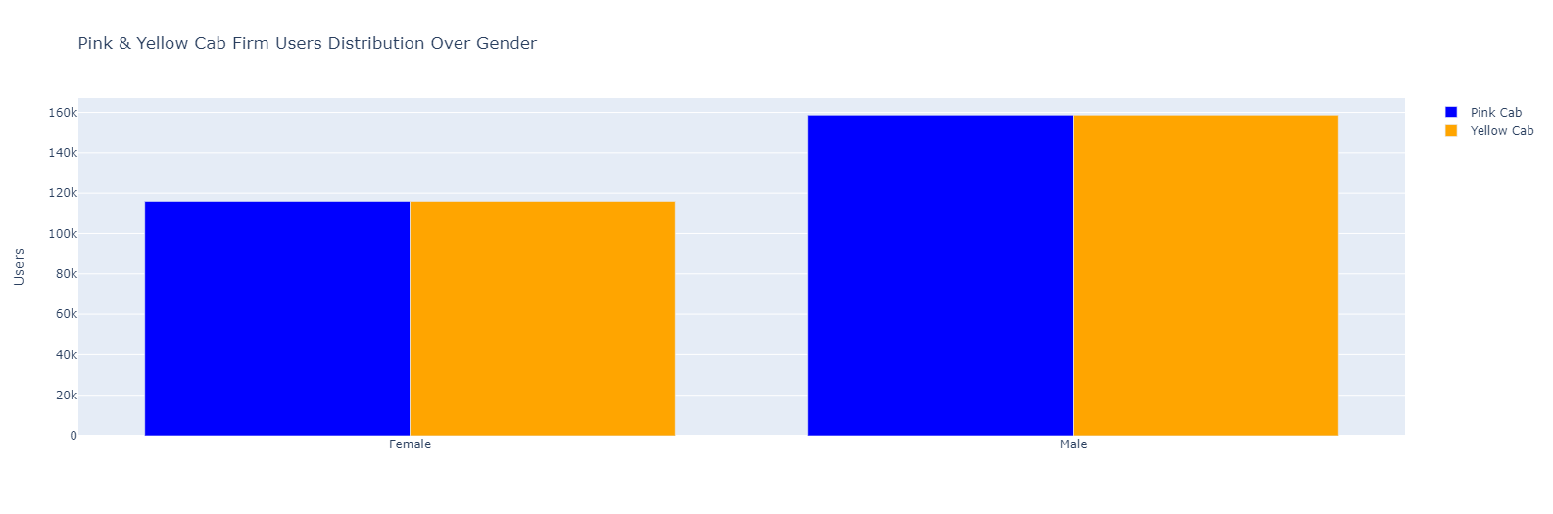

Slide 11
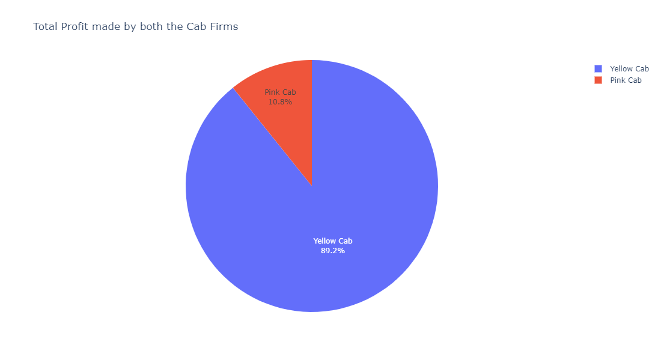

Slide 12
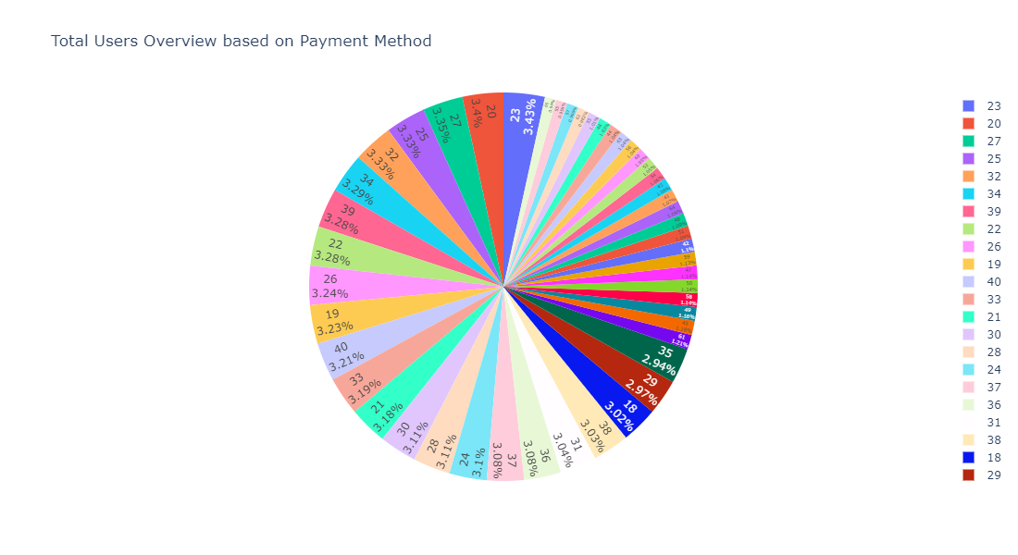

Slide 13
Pink Cab
Yellow Cab
Pink Cab charges same for both Male and Female Customers.
Yellow Cab charge less from Female Customers.
Female customers are around 20.5% out of the total Customers.
Female customers are around 25.5% out of the total Customers.
Sum of Profit Margin is low (2016-2018) compared to Yellow Cab.
Sum of Profit is high each year (2016-2018) compared to Pink Cab.
Pink Cabs increase margins with increase in number of Transactions.
Rides are in the range of approximately 2 to 48 KM.
Yellow Cab decrease Margins with the increase in Transaction.
Rides are in the range of approximately 2 to 48 KM.

Slide 14

Insights from the EDA
Profit Margin: For Yellow Cab the Profit Margin is higher per year from 2016 to 2018 in comparison to Pink Cab.
Yellow Cab decreases Margins with the increase in Transaction
Customers for Yellow Cab is highest in New York City which has the highest Cab Users of 28%.
Yellow Cab has 89.2% overall profit compared to Pink Cab which is 10.8%
On the basis of the above points, Yellow Cab is recommended for investment.

